Slide 1
CSE 205
Digital Logic Design
Week 5
Dr. Mahmuda Naznin

Slide 2
Magnitude Comparators
Compares two numbers, determines their relative magnitude.
We look at a 4-bit magnitude comparator;
A= A3 A2 A1 A0, B=B3 B2 B1 B0
Two numbers are equal if all bits are equal.
A=B if A3=B3 AND A2=B2 AND A1=B1 AND A0=B0
Xi= AiBi + Ai’Bi’ ; Ai=Bi Xi=1 (remember exclusive NOR?)

Slide 3
Magnitude Comparators
How do we know if A>B?
1. Compare bits starting from the most significant pair of digits
2. If the two are equal, compare the next lower significant bits
3. Continue until a pair of unequal digits are reached
4. Once the unequal digits are reached, A>B if Ai=1 and Bi=0, A<B if Ai=0 and Bi = 1
A>B = A3B3’+ X3A2B2’+ X3X2A1B1’ + X3X2X1A0B0’
A<B = A3’B3 + X3A2’B2 + X3X2A1’B1 + X3X2X1A0’B0
Xi=1 if Ai=Bi

Slide 4
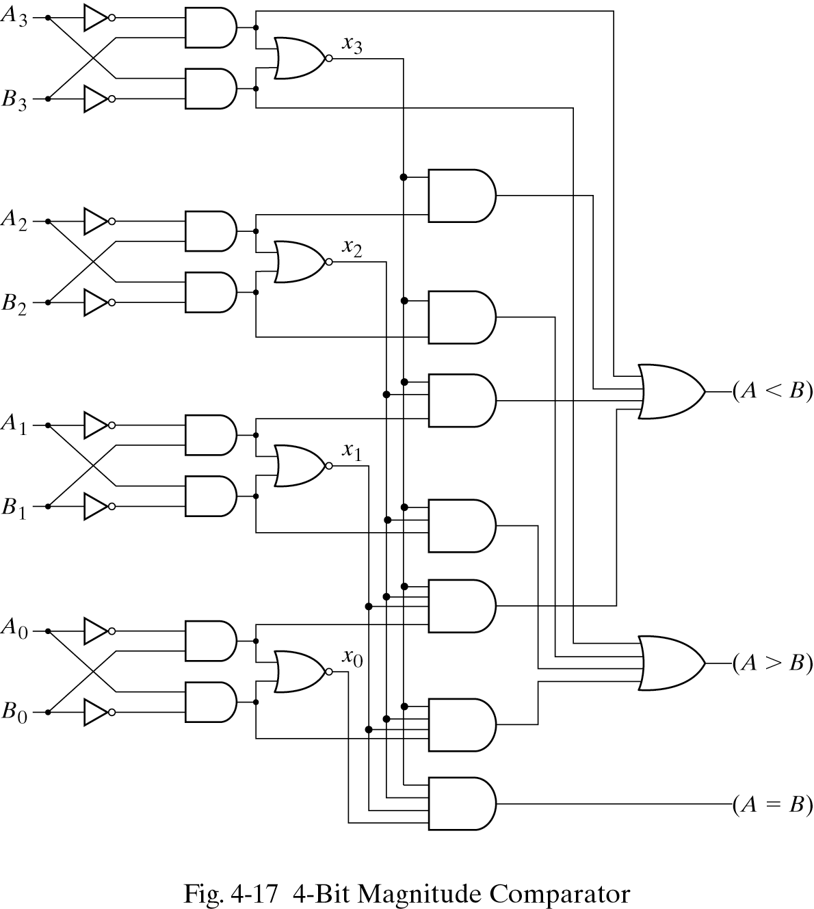
Magnitude Comparators
A3=B3 ?
X3A2’B2

Slide 5
Decoders
A decoder converts binary information from n input lines to a maximum of 2^{n} output lines
Also known as n-to-m line decoders where m< 2^{n}
Example 3-to-8 decoders.

Slide 6
Decoders: Truth Table
X Y Z D0 D1 D2 D3 D4 D5 D6 D7
0 0 0 1 0 0 0 0 0 0 0
0 0 1 0 1 0 0 0 0 0 0
0 1 0 0 0 1 0 0 0 0 0
0 1 1 0 0 0 1 0 0 0 0
1 0 0 0 0 0 0 1 0 0 0
1 0 1 0 0 0 0 0 1 0 0
1 1 0 0 0 0 0 0 0 1 0
1 1 1 0 0 0 0 0 0 0 1

Slide 7
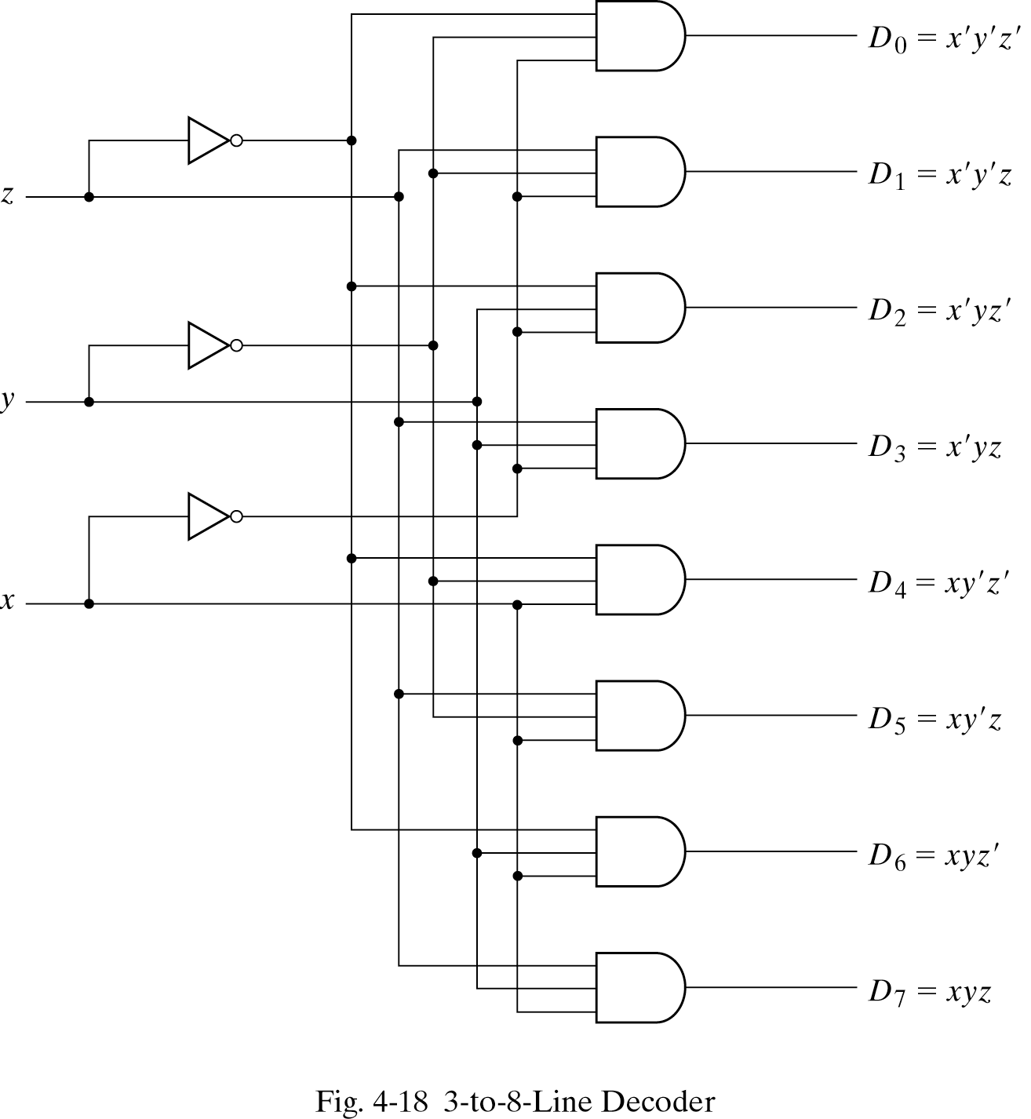
Decoders: AND implementation

Slide 8
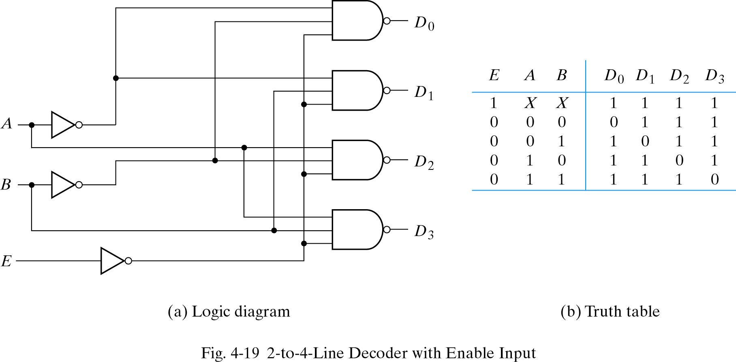
2-to-4 Decoder: NAND implementation
Decoder is enabled when E=0

Slide 9
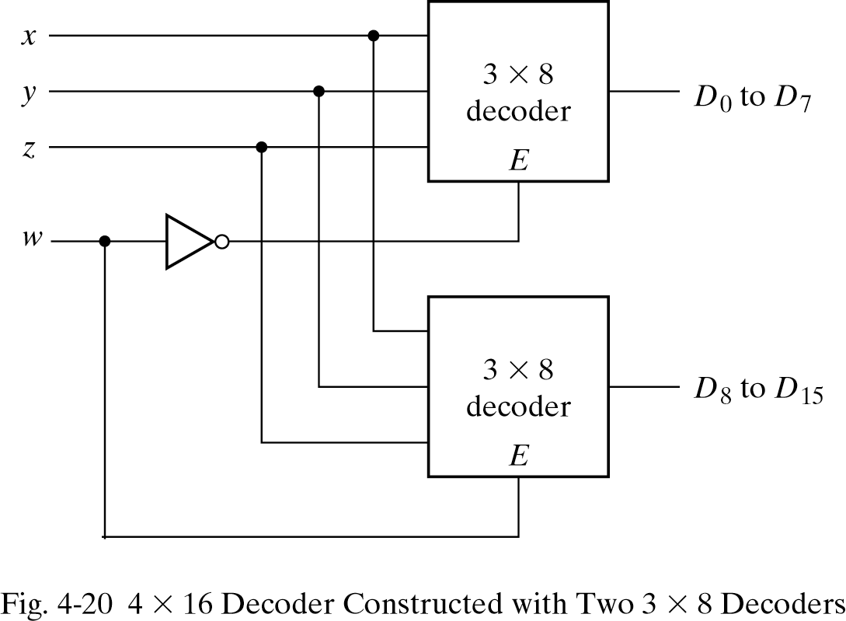
How to build bigger decoders?
We can combine two 3-to-8 decoders to build a 4-to-16 decoder.
Generates from
0000 to 0111
Generates from
1000 to 1111

Slide 10
Combinational Logic Implementation
A decoder provides the 2n minterms of n input variables.
Any function is can be expressed in sum of minterms.
Use a decoder to make the minterms and an external OR gate to make the sum.
Example: consider a full adder.
S(x,y,z) = Σ(1,2,4,7)
C(x,y,z) = Σ (3,5,6,7)

Slide 11
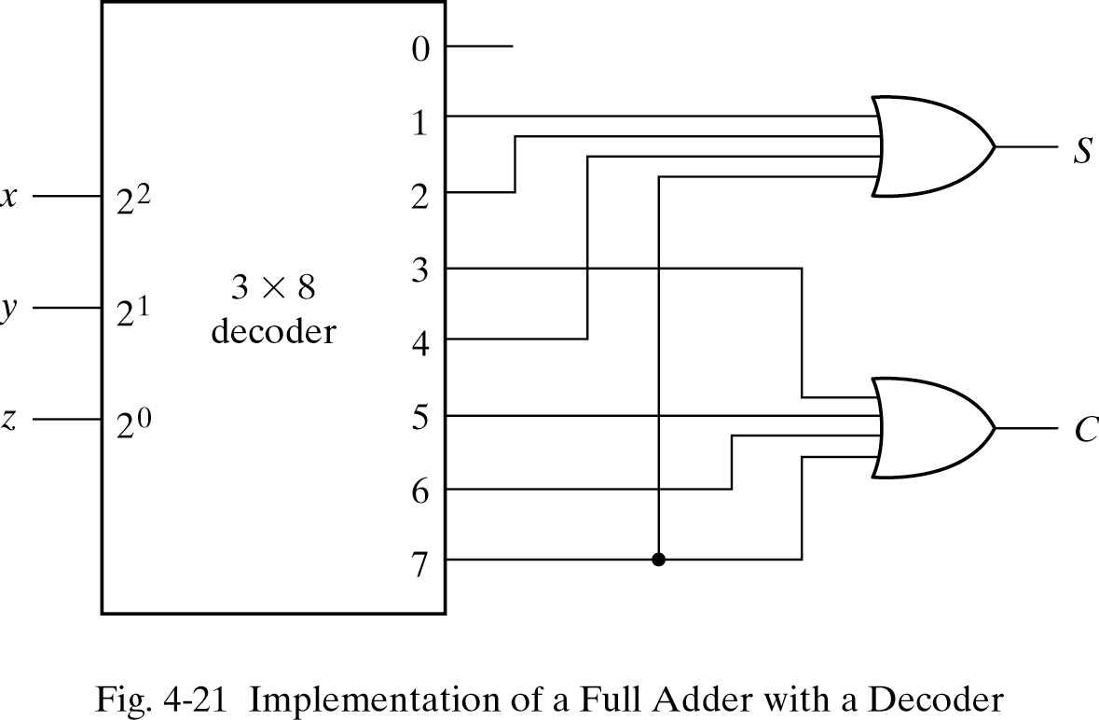
Combinational Logic Implementation

Slide 12
Encoders
Encoders perform the inverse operation of a decoder:
Encoders have 2^{n} input lines and n output line.
Output lines generate the binary code corresponding to the input value.

Slide 13
Encoders: Truth Table
Outputs Inputs
X Y Z D0 D1 D2 D3 D4 D5 D6 D7
0 0 0 1 0 0 0 0 0 0 0
0 0 1 0 1 0 0 0 0 0 0
0 1 0 0 0 1 0 0 0 0 0
0 1 1 0 0 0 1 0 0 0 0
1 0 0 0 0 0 0 1 0 0 0
1 0 1 0 0 0 0 0 1 0 0
1 1 0 0 0 0 0 0 0 1 0
1 1 1 0 0 0 0 0 0 0 1
z=D1+D3+D5+D7 y=D2+D3+D6+D7 x=D4+D5+D6+D7

Slide 14
Priority Encoders
Encoder limitations:
If two inputs are active, the output is undefined.
Solution: we need to take into account priority.
What if all inputs are 0?
Solution: we need a valid bit
Input Output
D0 D1 D2 D3 x y v
0 0 0 0 X X 0
1 0 0 0 0 0 1
X 1 0 0 0 1 1
X X 1 0 1 0 1
X X X 1 1 1 1

Slide 15
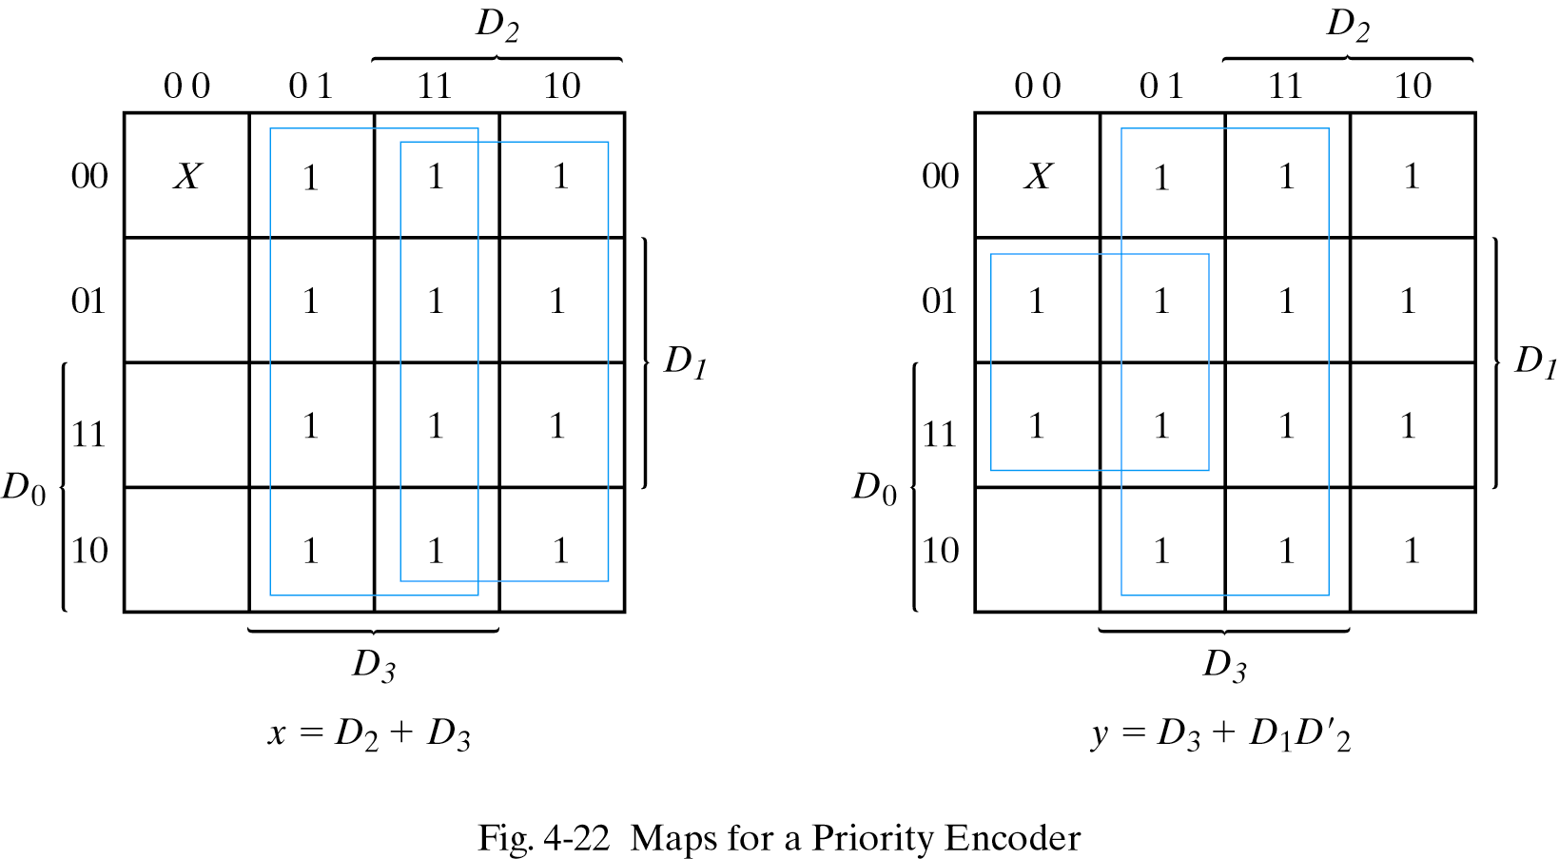
Priority Encoders: Map

Slide 16
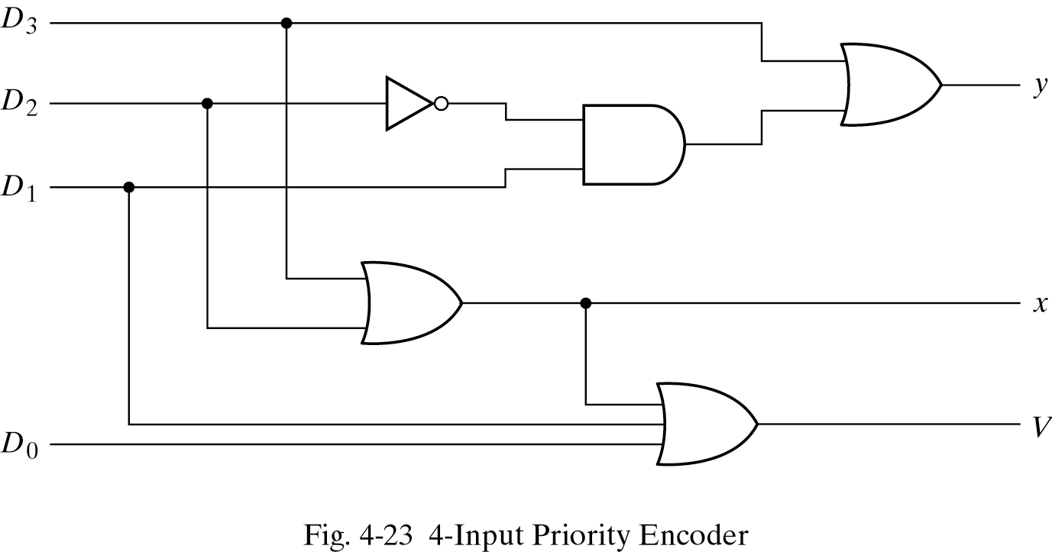
Priority Encoders: Circuit

